Slide 1
Business Location Explore in Toronto
Bin Yu
2020.04.21
Peer-graded Assignment for Course Applied Data Science Capstone, Week 4/5

Slide 2
Business Location Explore in Toronto
Contents
1. Introduction
2. Data Collection
3. Methodology
4. Result
5. Discussion
6. Conclusion

Slide 3
1. Introduction
1.1 Business Requests
1.2 Analytic Approach

Slide 4
1.1 Business Requests
Generate The location problem
Location to start a new business
We assume:
An investor wants to start a new business to serve Chinese food in downtown Toronto due to its density of population, higher average income, as well as the diversity of culture.

Slide 5
1.2 Analytic Approach
A good location should satisfy the two criteria at the same time:
(1) Sufficient demand
(2) Insufficient support

Slide 6
2. Data Collection
2.1 Scrape location info in Toronto
2.2 Fetch all 'FOOD' venues in Toronto
2.3 Show venues on map

Slide 7
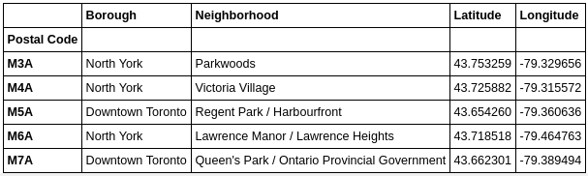
2.1 Scrape location info in Toronto
Step(1) Fetch postal code in Toronto
Step(2) Attaching geo info for each postal code

Slide 8
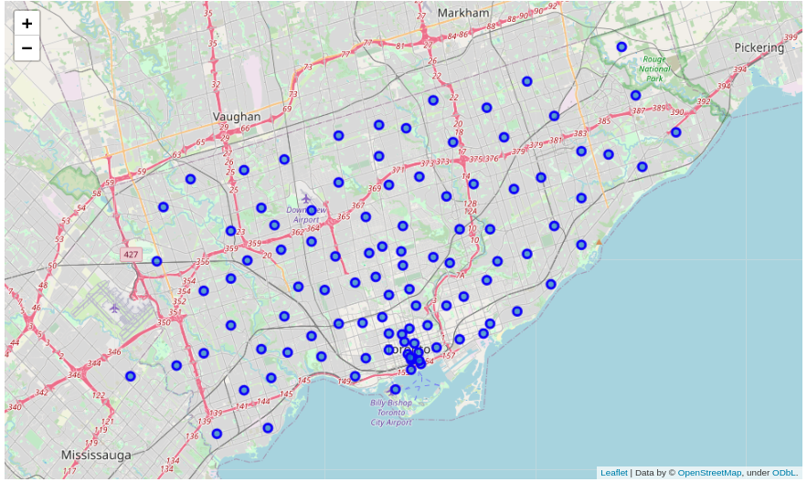
2.1 Scrape location info in Toronto
Step (3) Visualization areas on map

Slide 9
2.2 Fetch all 'FOOD' venues in Toronto
Step(1) First we set API credentials
Step(2) Fetch data via FourSquare API
Step(3) Review venues contains Restaurant in their Name

Slide 10
2.3 Show venues on map
Step (1) Find the center of the map
Step (2) Mark the venues on maps

Slide 11
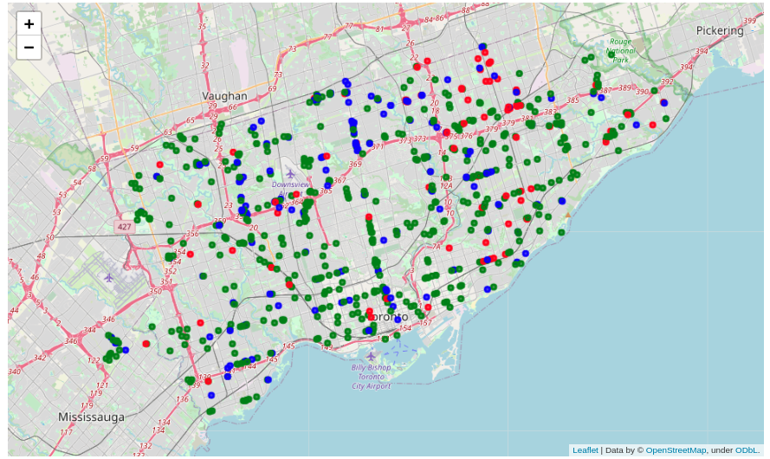
Mark the Restaurants on maps

Slide 12
3. Methodology
3.1 Definition of Sufficiency and InSufficiency
3.2 Isolation Forest Anomaly Dection

Slide 13
3.1 Definition of Sufficiency and InSufficiency

Slide 14
3.2 Isolation Forest Anomaly Dection

Slide 15
4. Result

Slide 16
5. Discussion

Slide 17
6. Conclusion

